Slide 1

Puberty and Growing up
RSHE (Relationships, Sex and Health Education)
To achieve our best

Slide 2
Aims of today’s session
Discuss puberty and its impact on children with SEND
Give parents and carers an overview of the importance of teaching RSHE in schools
Provide parents and carers with an overview of what is covered in schools
Have an opportunity to discuss areas of growing up parents and carers would like additional support with.
​Share strategies and resources to support young people growing through puberty

Slide 3
The Impact of Puberty on Children with Autism, SLD and PMLD
Puberty involves significant physical and hormonal changes, which may be challenging for children with learning difficulties, Autism and PMLD to understand.
Social and emotional development may be delayed or expressed differently.
Sensory sensitivities may be heightened during puberty.
Difficulty in communication may make it harder to express discomfort or confusion.
Notes:
During puberty children undergo various Physical changes - growth of body hair, changes in their voice, menstruation.
These may be confusing or distressing, especially for those who have limited verbal communication or expressive communication skills.
Sensitivities may heighten during this period, and the physical changes could cause discomfort or anxiety, such as the feeling of new body sensations, hygiene routines, and the onset of menstruation
Emotional changes are another hallmark of puberty. For children with SEND, these changes may manifest in:
Increased emotional sensitivity or difficulty processing emotions.
Challenges in understanding or expressing complex emotions like sexual attraction, confusion about gender identity, or frustration with body changes.
Mood swings and emotional outbursts, which are already common in puberty, may be more pronounced or misunderstood if the child has communication difficulties.
Social Changes
Puberty brings increased awareness of social dynamics, and this can be challenging for children with Autism SEND who may struggle with social communication and understanding social cues. These difficulties may lead to:
Social isolation or confusion in peer interactions.
Difficulty understanding the norms surrounding friendships and romantic relationships.
Challenges in expressing consent or discomfort, particularly in situations involving personal space or physical touch.

Slide 4
Understanding Sexual Development in Children with a disability
Sexual development can be delayed or atypical for children with a disability.
Importance of teaching boundaries, appropriate behaviour, and respect for others.
Educating children on body awareness, privacy, and consent will be prioritised.
Addressing challenging behaviours related to sexual curiosity or exploration in a sensitive and appropriate manner.

Slide 5
Recognising the Unique Challenges Faced by Children with Complex Needs
Children with SEND experience puberty in ways that differ significantly from neurotypical children. Some of the unique challenges include:
Communication Barriers: Many children will have limited verbal communication, which can make it difficult for them to express their feelings or concerns about the changes they are experiencing.
Sensory Sensitivities: Children with Autism may have heightened or altered sensory experiences, making the physical changes of puberty more overwhelming.
Understanding Social Norms: Children with Autism may struggle with understanding the complex social rules around sexuality, personal boundaries, and emotional regulation.
Increased Anxiety and Behavioral Issues: The unpredictability of bodily changes and social expectations can lead to heightened anxiety, which may result in behavioral challenges like aggression, self-injury, or withdrawal.

Slide 6
Autism, SLD and RSHE
“Autism is a lifelong developmental disability that affects how a person communicates with, and relates to, other people. It also affects how they make sense of the world around them”. Understanding and relating to other people, and taking part in everyday family and social life may be harder for them.
But will not stop pupils developing physically and emotionally.
Severe Learning Difficulties / PMLD - All children, regardless of their diagnosis, will develop and go through puberty.
Notes:
All of you know the impact of Autism on learning, and the impact of any learning difficulties on how our young people are going to process their changing bodies, how they would communicate those changes and any questions or worries they may have. What is really important to keep in mind is that all our young people are going to be developing physically and emotionally like any of their peers.
Developmental delays and severe learning difficulties will not delay the onset of puberty or the signs children will display, unless of course a child has a condition or syndrome affecting their hormonal development.

Slide 7
The Importance of a Holistic Approach
A holistic approach to supporting children through puberty is essential to ensure their emotional, physical, and social needs are met. This approach involves:
Physical Care
Emotional Support
Social Skills Training
Professional Support
Notes:
Physical Care: Teaching and assisting with self-care tasks, such as menstrual hygiene, body awareness, and grooming. This may involve creating a routine that the child can understand and follow, with consistent support.
Emotional Support: Providing consistent, clear explanations about the changes happening to their body in a way they can understand. Visual aids, social stories, or communication boards may be helpful for children with limited verbal communication.
Social Skills Training: Offering structured social skills training to help children understand appropriate social behaviors, boundaries, and relationships. This might include teaching concepts like personal space, consent, and respecting others' privacy.
Professional Support: Collaboration with healthcare professionals such as doctors, therapists, and educators is crucial in providing a well-rounded support system. Specialists in autism and PMLD can offer tailored strategies for navigating the challenges of puberty.

Slide 8
How schools teach young people about puberty and growing up
Through science lessons (body parts, life cycles of plants and animals, reproduction, etc
PSHE lessons - self-awareness, emotions, friendships, families
Literacy sessions - books representing the learners (autism, physical or learning difficulties, cultures and religions)
Communication - pupils being taught to express simple thoughts, including yes/no/preferences -CONSENT
Integrated within the school day - breaks and lunch times, developing friendships, turn taking
Targeted RSHE sessions when things occur - support understanding about appropriate touching, periods, etc
Boys and girls groups for targeted interventions/sessions

Slide 9
Schools’ legal obligations
Pupils need knowledge that will enable them to make informed decisions about their wellbeing, health and relationships and to build their self-efficacy.
Prepare pupils for the opportunities, responsibilities and experiences of adult life.
Promote the spiritual, moral, social, cultural, mental and physical development of pupils, at school and in society.
The Relationships Education, Relationships and Sex Education and Health Education (England) Regulations 2019 make Relationships Education compulsory for all pupils in primary schools and Relationships and Sex Education (RSE) compulsory for all pupils in secondary schools. They also make Health Education compulsory in all schools.
Notes:
To embrace the challenges of creating a happy and successful adult life, pupils need knowledge that will enable them to make informed decisions about their wellbeing, health and relationships and to build their self-efficacy. Pupils can also put this knowledge into practice as they develop the capacity to make sound decisions when facing risks, challenges and complex contexts.
High quality, evidence-based and age-appropriate teaching of these subjects can help prepare pupils for the opportunities, responsibilities and experiences of adult life. They can also enable schools to promote the spiritual, moral, social, cultural, mental and physical development of pupils, at school and in society.
The Relationships Education, Relationships and Sex Education and Health Education (England) Regulations 2019 make Relationships Education compulsory for all pupils in primary schools and Relationships and Sex Education (RSE) compulsory for all pupils in secondary schools. They also make Health Education compulsory in all schools.
Pupils with autism and learning difficulties are more likely to lack social understanding and therefore schools have a responsibility to teach them what is socially acceptable and what isn’t. All schools have a duty to deliver RSHE in a way pupils can understand.

Slide 10
Schools’ legal obligations
Special schools have flexibility to design and plan age-appropriate subject content. Therefore teaching the primary content in secondary lessons to pupils who need to build knowledge before any secondary content is taught, if needed.

Slide 11
School’s legal obligations
In all schools, when teaching RSHE, the religious background of all pupils must be taken into account when planning teaching, so that the topics that are included in the core content in this guidance are appropriately handled.
Relationships Education, RSE and Health Education must be accessible for all pupils.
In special schools and for some SEND pupils in mainstream schools there may be a need to tailor content and teaching to meet the specific needs of pupils at different developmental stages. As with all teaching for these subjects, schools should ensure that their teaching is sensitive, age-appropriate, developmentally appropriate and delivered with reference to the law.
Notes:
A good understanding of pupils’ faith backgrounds and positive relationships between the school and local faith communities help to create a constructive context for the teaching of these subjects.
This is particularly important when planning teaching for pupils with special educational needs and disabilities who represent a large minority of pupils. High quality teaching that is differentiated and personalised will be the starting point to ensure accessibility.

Slide 12
Parents’ right to withdraw
Parents and carers have the right to withdraw pupils from sex education (but not Relationships or Health Education).
Parents have the right to request that their child be withdrawn from some or all of sex education delivered as part of statutory RSE.
Children cannot be withdrawn from science lessons.
Notes:
The DfE has just launched a consultation on relationship, RSE and health education, with a view of updating the curriculum. The proposed curriculum is looking to introduce age limits to ensure children are not being taught about sensitive and complex topics before they are fully ready to understand them. We already think about children’s understanding when devising a curriculum in special schools, especially when teaching PSHE and RSHE, and we ensure that the topic is appropriate to the developmental age of the children, not their chronological age. The new proposed curriculum will no longer be teacher the concept of gender identity, so that particularly in mainstream, children don’t start to question their gender when they would not have done so otherwise. The guidance makes it clear that parents have a legal right to know what their children are being taught in RSHE and can request to see teaching materials.

Slide 13
Gaps in our pupils’ knowledge
It is estimated that a person with SEN has an average of 350 relationships in their lifetime (parents, families, teachers, respite provisions, bus drivers, adults providing intimate care, etc)
Many of these relationships get broken when people leave.
Formal lessons, via schools’ RSHE sessions are their only way to learn to understand relationships, growing up and what is/isn’t appropriate, and it is their right.
It is schools’ and parents’ responsibility to teach young people theirs.

Slide 14
Importance of teaching our children about growing up, their bodies and keeping safe.
Children with disabilities are 3.7 times more likely than other children to be abused or neglected. Sometimes this is because of high care needs, increased vulnerability or the range of other factors that affect other children.
Emotional changes
The pupils’ legal rights and entitlement to access the RSHE curriculum.
Notes:
The NSPCC has looked at studies and case reviews and reports that the lack of effective RSHE or safety and awareness work with disabled children adds to their risk of being abused.
– these can be distressing if they don’t understand what is happening to their bodies and emotions.
It is the school’s duty to deliver it in a way they can understand.

Slide 15
How did you get your ideas, knowledge and beliefs in sex, sexuality, relationships and gender?
Parents/grandparents/siblings – morals and values
Faith/culture
School/biology lessons/school nurse
Friends (can it happen for our pupils?)
Media (TV, soaps, music, ads, newspapers and music, films and books)
Self discovery (changes – experimentation/exploration: when are they able to be on their own?)
Role models – who will they be?
Partners – forming relationships are difficult and most of our pupils will need caring throughout their lives by many different adults.
Pupils in schools would not access many of the above learning opportunities.

Slide 16





If you cannot understand the text in magazines and online, what do you make of these? How about music videos? How about soaps? YouTube? TikTok?

Slide 17
What needs to be taught (depending on level/needs)
Content: depending on age, ability, level of development and needs, schools (at primary and secondary level) will teach anything from personal hygiene to going through puberty (such as having a period or masturbation).
Schools cover RSHE within science (changing bodies, growing up, puberty, periods, how the body work), PSHE (self awareness, making choices, personal hygiene, learning to say no, feelings, relationships-friendships- etc), dealing with prejudice, social understanding).

Slide 18
What needs to be taught (depending on level/needs)
Discriminative learning: when and where to dress/undress, masturbate, touch other people and related behaviours (private and public places)
Personal hygiene
Body parts and function, including puberty and bodily changes
Sex and relationship programme in reproduction, relationships, safe sex, STDs and parenthood.

Slide 19
Strategies for Teaching Puberty and Relationships
Using visual supports (e.g., social stories, pictures, and videos) to teach puberty and relationships.
Using clear, consistent language, and concrete examples.
Breaking down complex concepts into smaller, manageable parts.
Using alternative communication methods (AAC systems) for pre-verbal children.
Reinforcing positive behaviours and using role-play scenarios, social stories, visuals to teach social skills.
Discreet sessions
Social stories - both for home and school
Explicit schedules - what to do when (changing a pad, washing, etc)

Slide 20
How?
Discreet sessions
Social stories - both for home and school
Explicit schedules - what to do when (changing a pad, washing, etc)
Drama / role play

Slide 21
Pre-formal / Semi-formal** | My Body is My Body Puberty, my changing body Public and private behaviours |  | Relationships Relationships with myself, others, family and friends Managing feelings and behaviours |  | Looking after Myself Personal sensitivity and positive choices [health and nutrition] Personal care and hygiene [including menstruation]
Formal** | My Body is My Body Puberty - how my body changes Public and private behaviours |  | Relationships Relationships, sex education within a context of loving, established relationships Relationships, making safe choices |  | Looking after Myself Making safe choices [health and nutrition] Reproduction as appropriate [science context- animals and humans]
Reaching Higher** | My Body is My Body |  | Relationships |  | Looking after Myself
 | Puberty and personal hygiene - how my body changes | Public and private behaviours | Consent and assertiveness - learning to keep safe | Understanding bodily needs [menstruation, wet dreams, arousal, masturbation and dignity] | Health [sexual choices, testicular and breast cancer awareness] | Preparing for adulthood
** These topic cycles are flexible as teachers will tailor the curriculum to current class needs**
https://www.learnandthrive.org.uk/learning-for-life
https://www.learnandthrive.org.uk/learning-for-life-homepage

Slide 22
Common RSE issues in school and home
Working with families is key - schools and home need to have the same approach.
Rubbing/masturbation/inappropriate touching (incl. Behaviours of concern/aggression due to frustration)
Inappropriate touching other pupils/staff
Exposing themselves in public places
How to have positive relationships
Dealing with periods, pain, etc

Slide 23
Managing Challenging Behaviours Related to Puberty
Understanding the root causes of challenging behaviours related to puberty (e.g., sensory overload, emotional confusion).
Providing structure and routine to reduce anxiety.
Implementing positive behaviour support strategies.
Collaborating with the school and healthcare professionals to address behavioural concerns.
Recognising and celebrating small successes and progress.

Slide 24
The Role of Parents in Supporting Puberty Education
Parents as the primary educators and advocates.
Creating a safe and supportive environment at home for discussions around puberty.
Introducing body changes and hygiene routines in a way that is accessible and understandable for their children
Strategies for teaching puberty-related topics in small, manageable steps.

Slide 25
The Role of Parents in Supporting Puberty Education
Parents play a pivotal role in guiding their children through puberty.
Providing Consistent Reassurance
Advocacy
Encouraging Self-Advocacy
Creating Safe and Open Spaces
Notes:
Parents play a pivotal role in guiding children with Autism and PMLD through puberty. Their involvement includes:
Providing Consistent Reassurance: Offering reassurance and support during confusing or distressing moments. Parents can help their children make sense of the changes by using simple language, visual tools, or comforting routines.
Advocacy: Advocating for their child's needs in various settings, such as school, medical appointments, or community spaces. Parents can work with professionals to ensure that their child's transition through puberty is handled with understanding and appropriate support.
Encouraging Self-Advocacy: As children grow, it’s essential to help them understand their own needs and to communicate them as effectively as possible. This may include teaching the child to express when they are uncomfortable, anxious, or in need of assistance.
Creating Safe and Open Spaces: Ensuring that children feel comfortable discussing sensitive issues like body changes, relationships, and sexuality in a non-judgmental environment. This could involve using appropriate resources like books, videos, or counselors.

Slide 26
Suggested RSE Activities in the home
Draw around bodies
Draw around bodies and label parts, using correct words (and family names) and their purpose
What's in the bag? Puberty
Put together your own ‘puberty bag’ from household items. Discuss each one and why it’s used, e.g. deodorant, razors, tampons/pads, shower gel, washing powder, tissues, hair gel.
What's in the bag? Growing up
Same as above for contents of handbag; items support discussions about growing up
Social Stories
Respond to arising issues by regular reading of social stories (masturbation, periods, etc)
Anonymous questions box
Have an old shoe box, or similar, where children could post questions that they might not be able to ask you verbally.
Praise and thank them for their questions. Try to answer them using the webpages above to help provide age-appropriate, fact-based answers.
RSE Bingo
Watch the telly or a programme you enjoy on Netflix together. Every time you hear a sexist remark, a stereotype, or an unhealthy attitude -call it out! And use it as an opportunity to discuss RSE-related matters, asking your child what they think.

Slide 27
Useful websites for children (we recommend you watch them first so you are prepared for any questions)
Amaze.org- Puberty section (Age 9+)
Operation Ouch! How are babies made? (age 9-12)
Operation Ouch! Puberty (age 8-14)
Kids' Health - Menstruation
Male puberty - including wet dreams
Outspoken - information, advice and resources

Slide 28
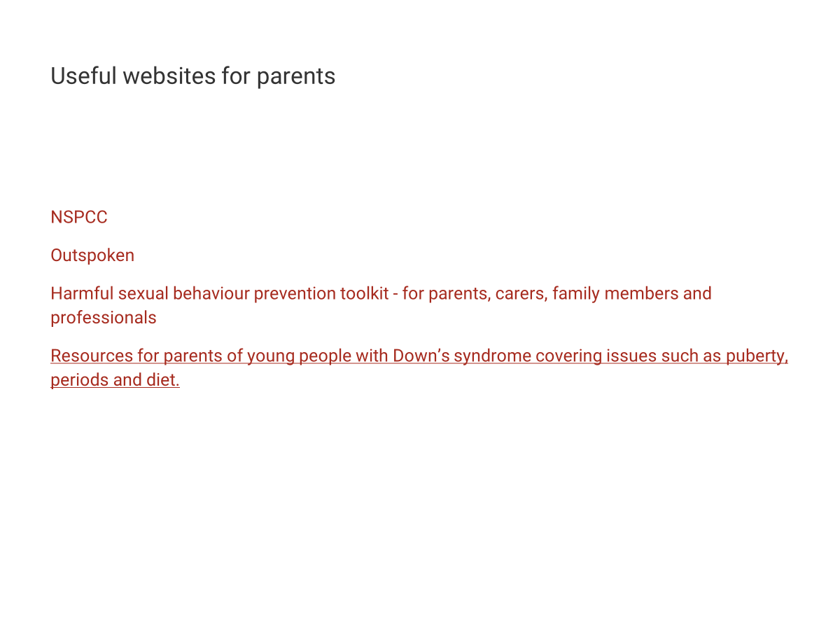

Slide 29
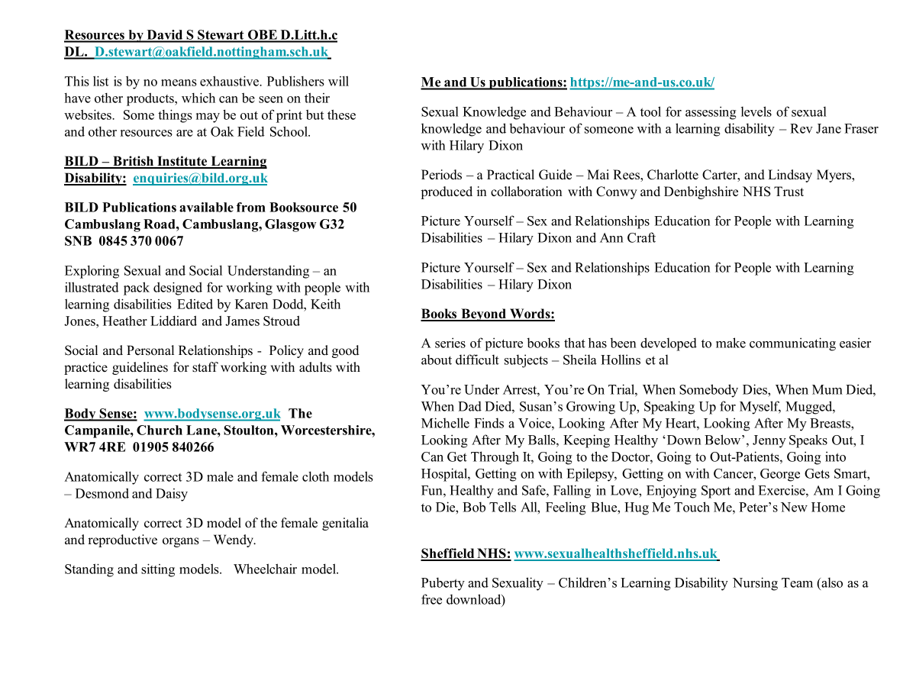

Slide 30
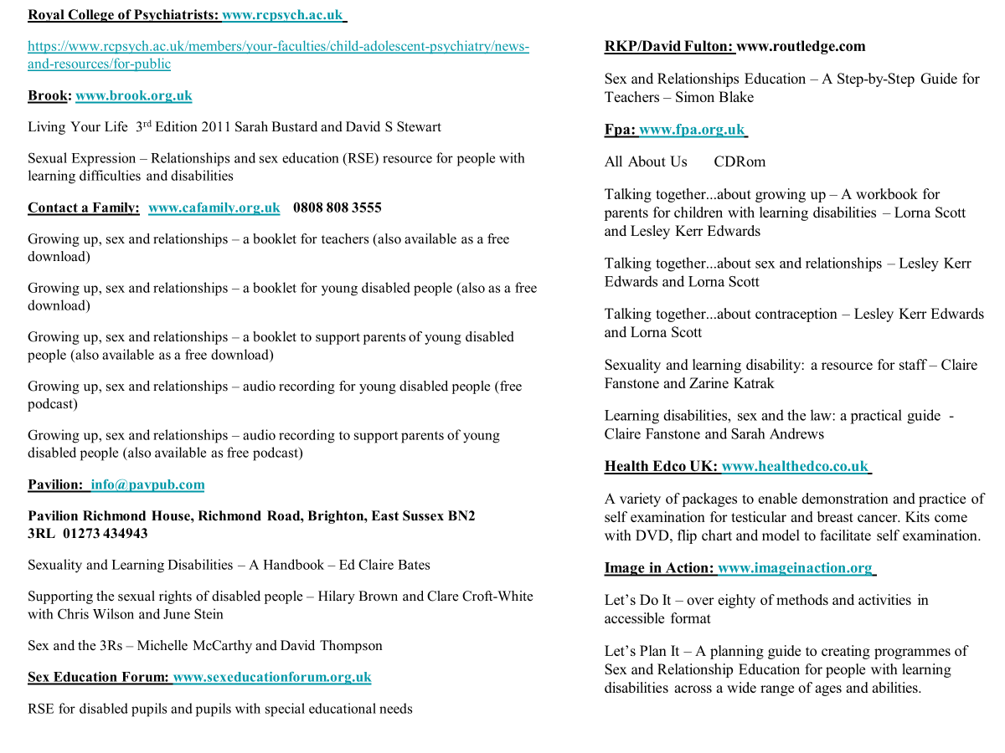
Useful websites for parents
NSPCC
Outspoken
Harmful sexual behaviour prevention toolkit - for parents, carers, family members and professionals
Resources for parents of young people with Down’s syndrome covering issues such as puberty, periods and diet.
Further support, advice and self-help
The National Autistic Society provides information and support for people with Autism and their families and for professionals. They are a very active organisation and offer some really useful information about strategies and approaches for supporting people with Autism.
Website
The British Institute of Learning Disabilities also have some useful information and further advice about a variety of common issues.
Website

Slide 31
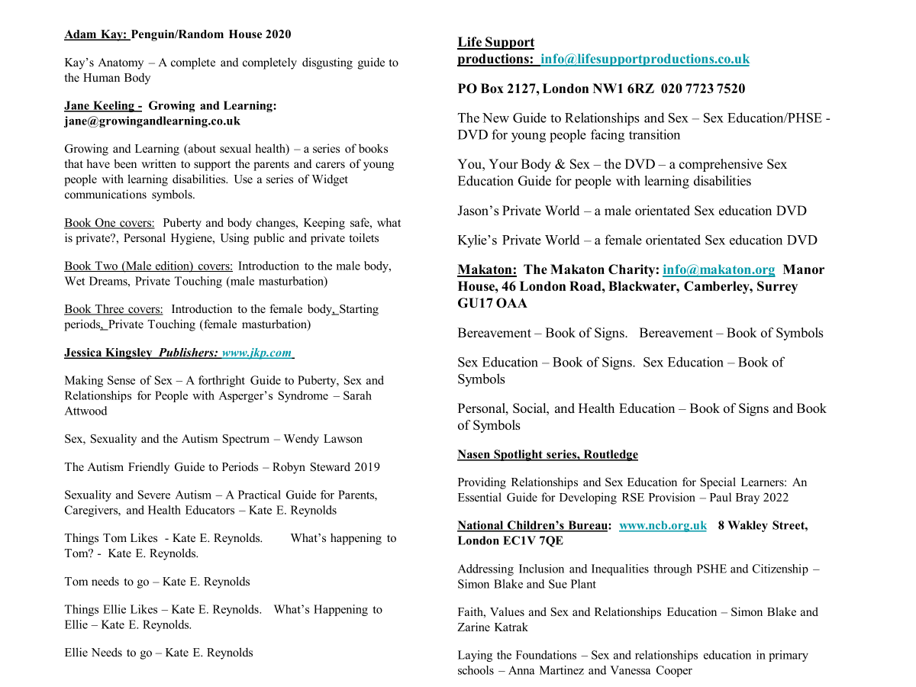

Slide 32
Questions?

Slide 33
Feedback form...won’t take long!
Name...........................
The session was : a) very useful
b) quite useful
c) not useful
The session was : a) too complicated
b) pitched at the right level
c) too easy
Confidence scale of addressing issues with your child before the training session?
Not confident Very confident
1 2 3 4 5 6 7 8 9 10
Confidence scale of addressing issues after training session?
Not confident Very confident
1 2 3 4 5 6 7 8 9 10
Any other comments?......................................................................................
Do you need any more info?.............................................................................
Thanks! ☺

